Slide 1
MODULE 19: PRE-EVACUATION PROCEDURES
TCCC TIER 1
All Service Members
TCCC TIER 2
Combat Lifesaver
TCCC TIER 3
Combat Medic/Corpsman
TCCC TIER 4
Combat Paramedic/Provider

Slide 2





TACTICAL COMBAT CASUALTY CARE (TCCC) ROLE-BASED TRAINING SPECTRUM
ROLE 1 CARE
NONMEDICAL PERSONNEL
MEDICAL PERSONNEL
ASM
CMC
CPP
CLS
YOU ARE HERE
STANDARDIZED JOINT CURRICULUM
2

Slide 3
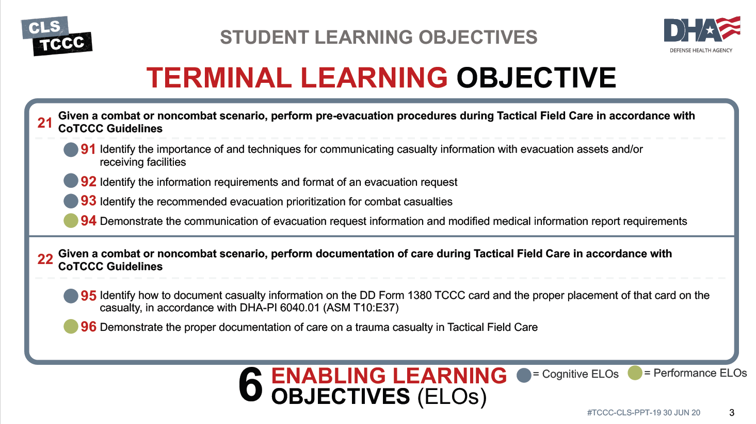


TERMINAL LEARNING OBJECTIVE
STUDENT LEARNING OBJECTIVES
6
ENABLING LEARNING OBJECTIVES (ELOs)
= Cognitive ELOs
= Performance ELOs
3

Slide 4


Three PHASES of TCCC
TACTICAL EVACUATION CARE
1 CARE UNDER FIRE
RETURN FIRE AND TAKE COVER
Quick decision-making:
▪ Consider scene safety
▪ Identify and control life- threatening bleeding
▪ Move casualty to safety
₂ TACTICAL FIELD CARE
COVER AND CONCEALMENT
Basic Management Plan:
▪ Maintain tactical situational awareness
▪ Triage casualties as required
▪ MARCH-PAWS assessment
TACTICAL EVACUATION CARE
More deliberate assessment and treatment of unrecognized
life-threatening injuries
Pre-evacuation procedures
Continuation of documentation
3
NOTE: This is covered in more advanced TCCC training!
YOU ARE HERE
4

Slide 5
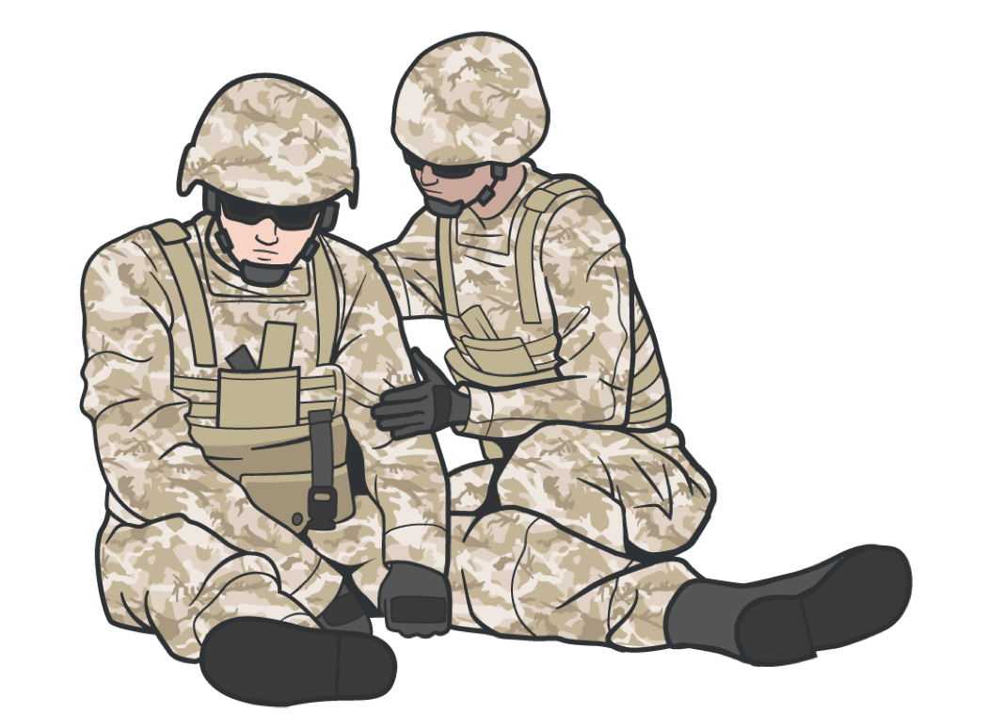
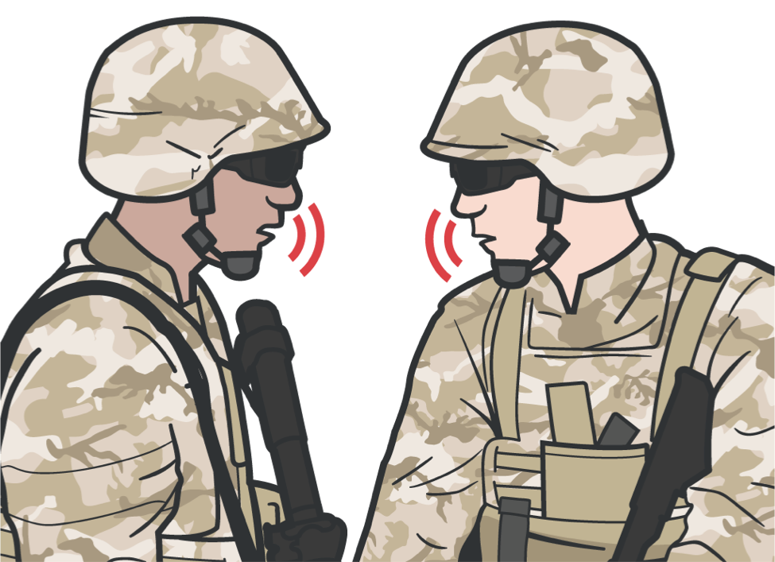
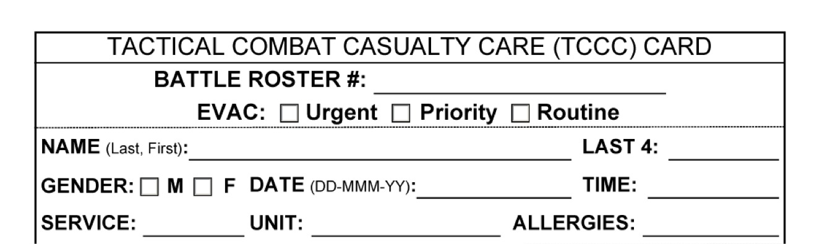
PRE-EVACUATION
COMMUNICATION
COMMUNICATE WITH EVACUATION AND MEDICAL ASSETS
Communicate with evacuation system to coordinate TACEVAC/MEDEVAC using
9-Line MEDEVAC request
Communicate with the casualty if possible
Encourage Reassure
Communicate immediately with tactical leader for
Status
Evac requirements Casualty treatment
Keep the casualty’s
DD Form 1380 up to date
Explain care each step of the way
5

Slide 6
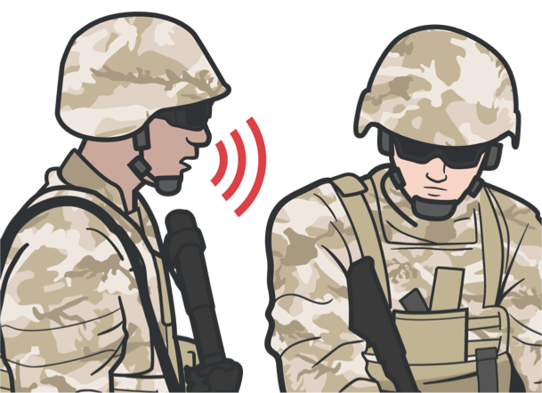
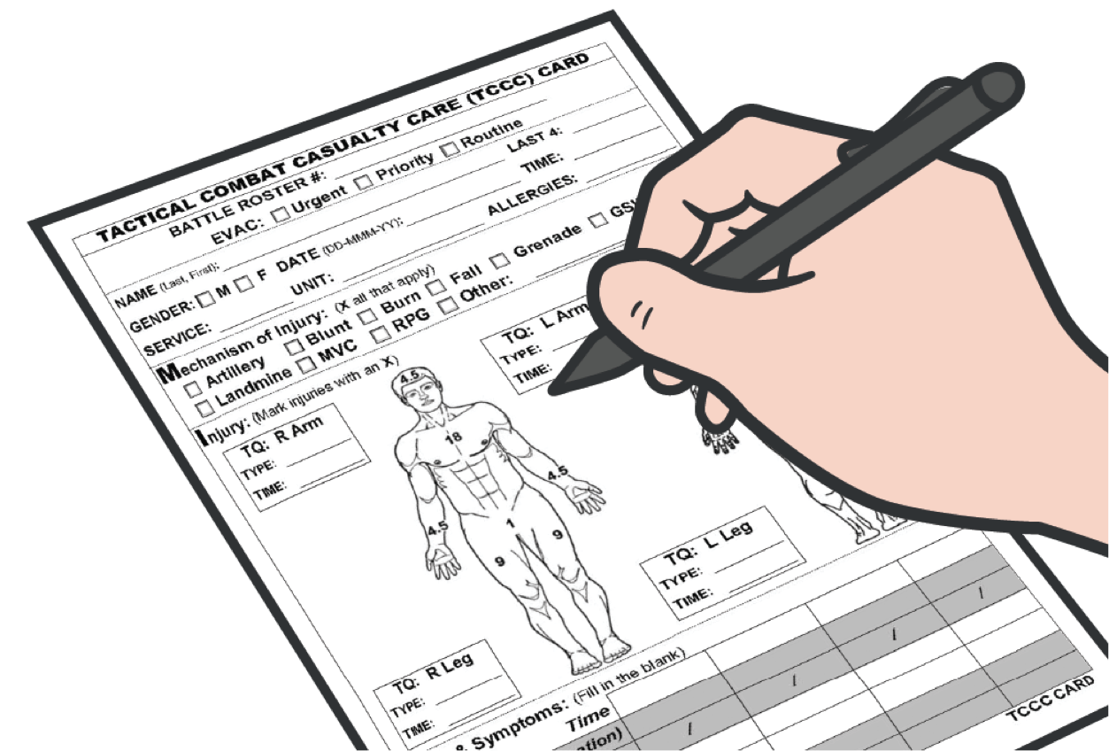
PRE-EVACUATION
COMMUNICATE RELEVANT CASUALTY DATA
HANDOFF WITH MEDIC OR MEDEVAC
When handing off the casualty to the medic or MEDEVAC, provide
DD Form 1380, including any additional information as needed
MIST report
May change as the casualty status and interventions performed change
Conveys additional evacuation information that may be required by theater commanders
Helps better prepare receiving facility
Communicate with evacuation system:
9-Line MEDEVAC request
MIST Report
Mechanism of injury
Injuries Symptoms Treatment
Relay the information following your standard operating procedures (SOPs)
Document all assessment and medical care (including interventions and medications) on the DD Form 1380
6

Slide 7
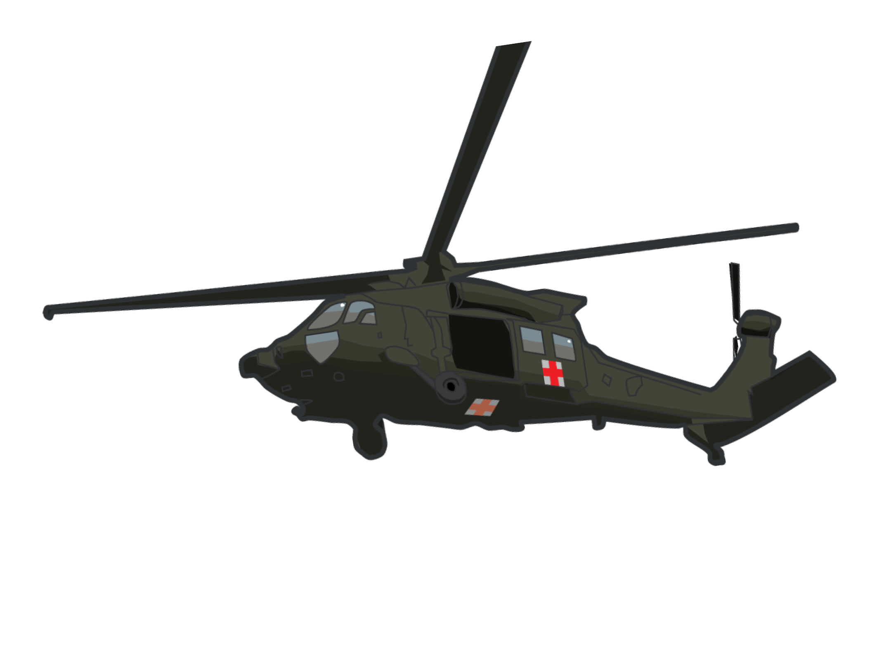
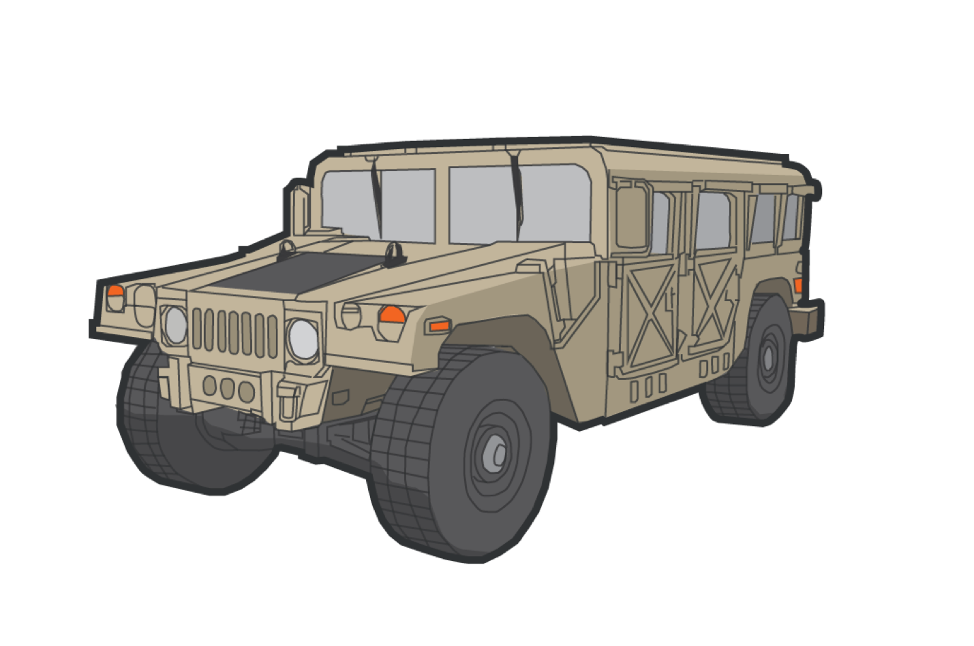
PRE-EVACUATION
REQUESTING EVACUATION OF CASUALTIES
Although the Combat Lifesaver is not a medical person, they may need to initiate the medical evacuation request
Depending on the tactical situation and available assets, the casualty may be evacuated by MEDEVAC or CASEVAC
MEDEVAC
Transport by medical personnel of the wounded, injured, or ill persons from the battlefield and/or other locations to Medical Treatment Facilities (MTFs)
Conducted with dedicated ground and air ambulances, properly marked and employed in accordance with the Geneva Conventions and the law of war
Involves the movement of unregulated and regulated patients
CASEVAC
Unregulated movement of casualties aboard ships, land vehicles, or aircraft
7

Slide 8

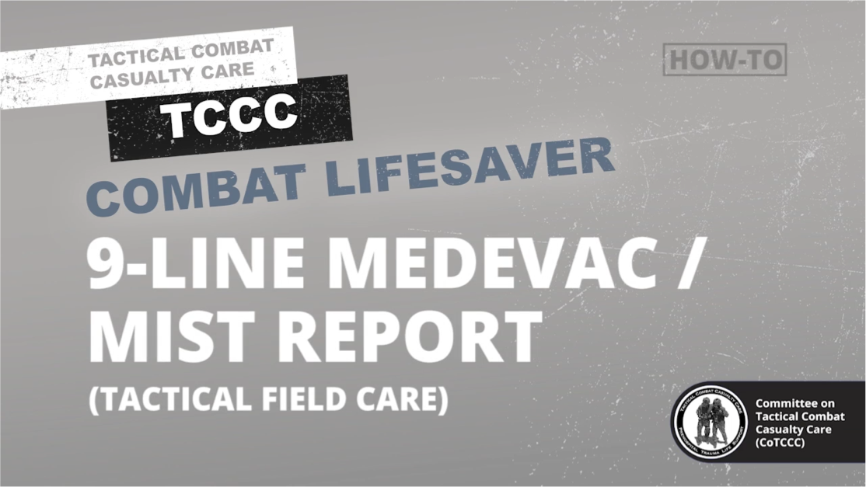
PRE-EVACUATION
MEDEVAC REQUEST KEY POINTS
9-Line and MIST Video
Every Service member must be prepared to transmit a MEDEVAC request
A MEDEVAC request is NOT a direct medical communication with medical providers, but a means of communicating evacuation requirements so aircraft resources can be launched as needed
Gather all information needed before initiating transmission
Use appropriate and mandated communications security and brevity codes when transmitting a MEDEVAC request in accordance with the operational plan
8

Slide 9

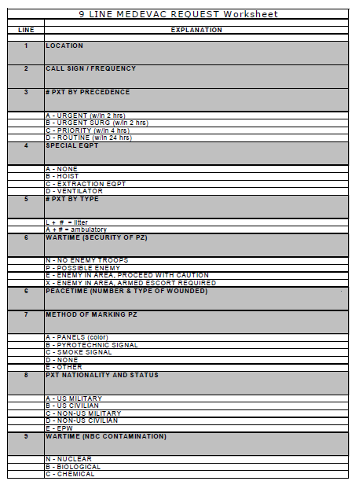
PRE-EVACUATION
9-LINE: MEDEVAC REQUEST LINES 1-5
NOTE: Lines 1-5 are the lines NEEDED to launch an asset
Location of the pickup site: (8-digit grid coordinate)
YOUR radio frequency, call signal, and suffix
1
2
3
Numbers of patients by precedence:
Urgent: <2 hours to save life, limb, or eyesight
Urgent Surgical: <2 hours to nearest surgical unit
Priority: <4 hours or could deteriorate to urgent
Routine: <24 hours
Convenience: Not a medical necessity
NOTE: If two or more categories are reported in the same request, insert the word "break" between each category
Special equipment required:
4
5
Numbers of patients by type:
(Encrypt using brevity codes):
Ex: L+# - number of litter casualties
Ex: A+# - number of ambulatory casualties
None
Hoist
Extraction equipment
Ventilator
Most common request: hoist, Stokes litter, and forest penetrator
9

Slide 10

PRE-EVACUATION
9-LINE: MEDEVAC REQUEST LINES 6-9
Security of the pickup site:
N = No enemy troops in the area; routine P = Possible enemy troops in the area
E = Enemy troops in the area; approach with caution
X = Enemy troops in area; armed escort required
6
7
Method of marking pickup site:
A = Panels
B = Pyrotechnic signal C = Smoke signal
D = None
E = Other
8
Patient Nationality and status:
(Encrypt using brevity codes) A = U.S. Military
B = U.S. Civilian
C = Non-U.S. Military
D = Non-U.S. Civilian
E = Enemy Prisoner (EPW)
9
CBRN Contamination: (Encrypt using brevity codes) C = Chemical
B = Biological
R = Radiological
N = Nuclear
#TCCC-CLS-PPT-19 30 JUN 20
10

Slide 11

SKILL STATION
Communication and Documentation (skill) 9-Line & Mist Report

Slide 12
PRE-EVACUATION
CASUALTY CATEGORIES
Ground medical personnel will determine EVAC categories of casualties
 | URGENT | URGENT SURGICAL | PRIORITY | ROUTINE | CONVENIENCE
 | <2 hours to save life, limb, or eyesight | <2 hours to nearest surgical unit | <4 hours or could deteriorate to urgent | <24 hours | Not a medical necessity
Examples | Tourniquets Corrected hemorrhage Traumatic Brain Injuries (TBIs) | Needle Decompression of the Chest (NDCs) Cricothyroidotomy Major internal bleeding Massive head trauma | Compensated shock Broken arm with loss of distal pulse 2nd-degree burns to a large portion of the abdomen or extremities | Abrasions Cardiac arrest Small fractures Frostbite 2^{nd-}/3rd-degree burns >70% of body surface area (BSA) | Used for administrative purposes for casualty movement

Slide 13
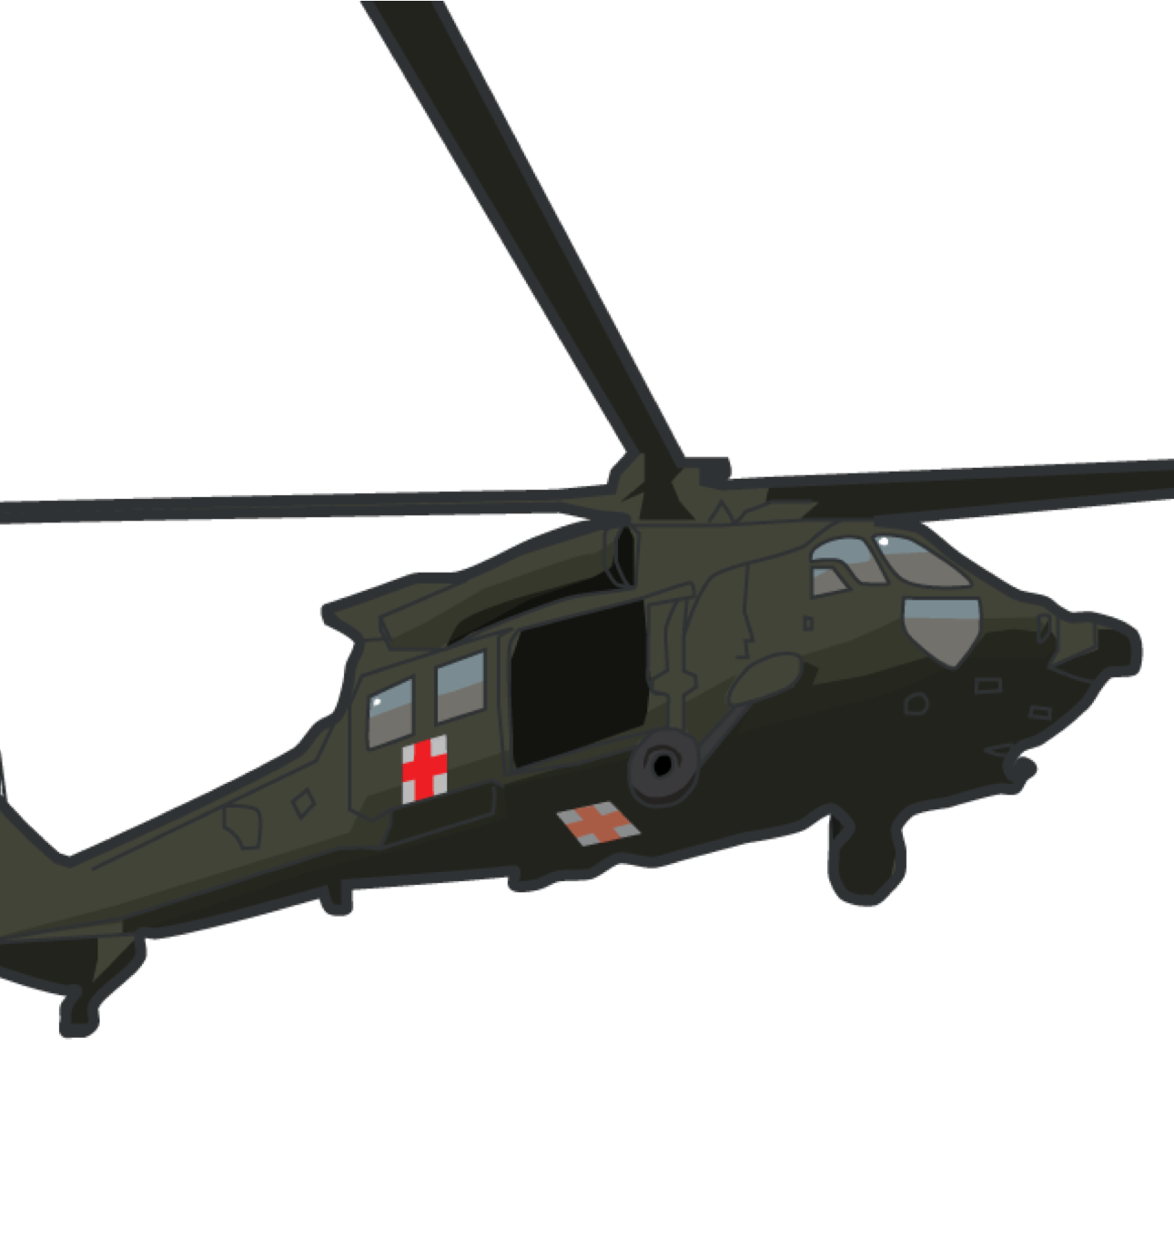
OVER-CATEGORIZATION
PRE-EVACUATION
OVER-CATEGORIZATION: the tendency to classify a wound or injury as being more severe than it actually is
Historically AND currently problematic
Proper casualty categorization is needed to ensure that those casualties in greatest need are evacuated first and receive the care required to help ensure their survival
Casualties will be picked up as soon as possible, consistent with available resources and pending missions
Urgent: <2 hours to save life, limb, or eyesight
Urgent Surgical: <2 hours to nearest surgical unit
Priority: <4 hours or could deteriorate to urgent
Routine:<24 hours
Convenience: not a medical necessity

Slide 14

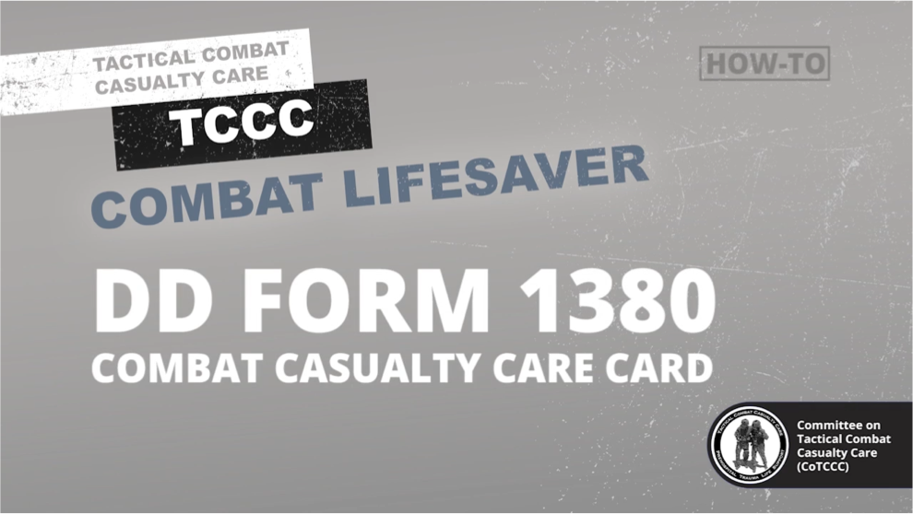

PRE-EVACUATION
COMMUNICATE
1.WITH THE CASUALTY
Encourage, reassure, and explain care
DOCUMENT
1. CASUALTY ASSESSMENT FINDINGS
2. MEDICAL AID RENDERED
2.WITH TACTICAL LEADERSHIP
Provide leadership with the casualty status and location
3. CHANGES IN CASUALTY STATUS
DD FORM 1380 How-To Video
Video can be found on DeployedMedicine.com
3.WITH MEDICAL PERSONNEL
Discuss with the responding medics the casualty’s injuries and symptoms, as well as any medical aid provided
MIST Report is generated from Casualty’s DD Form 1380
Attach DD Form 1380 to the casualty in a prominent location (wrist, belt loop of pants, etc.)

Slide 15
SKILL STATION
Communication and Documentation (Skill) DD Form 1380

Slide 16
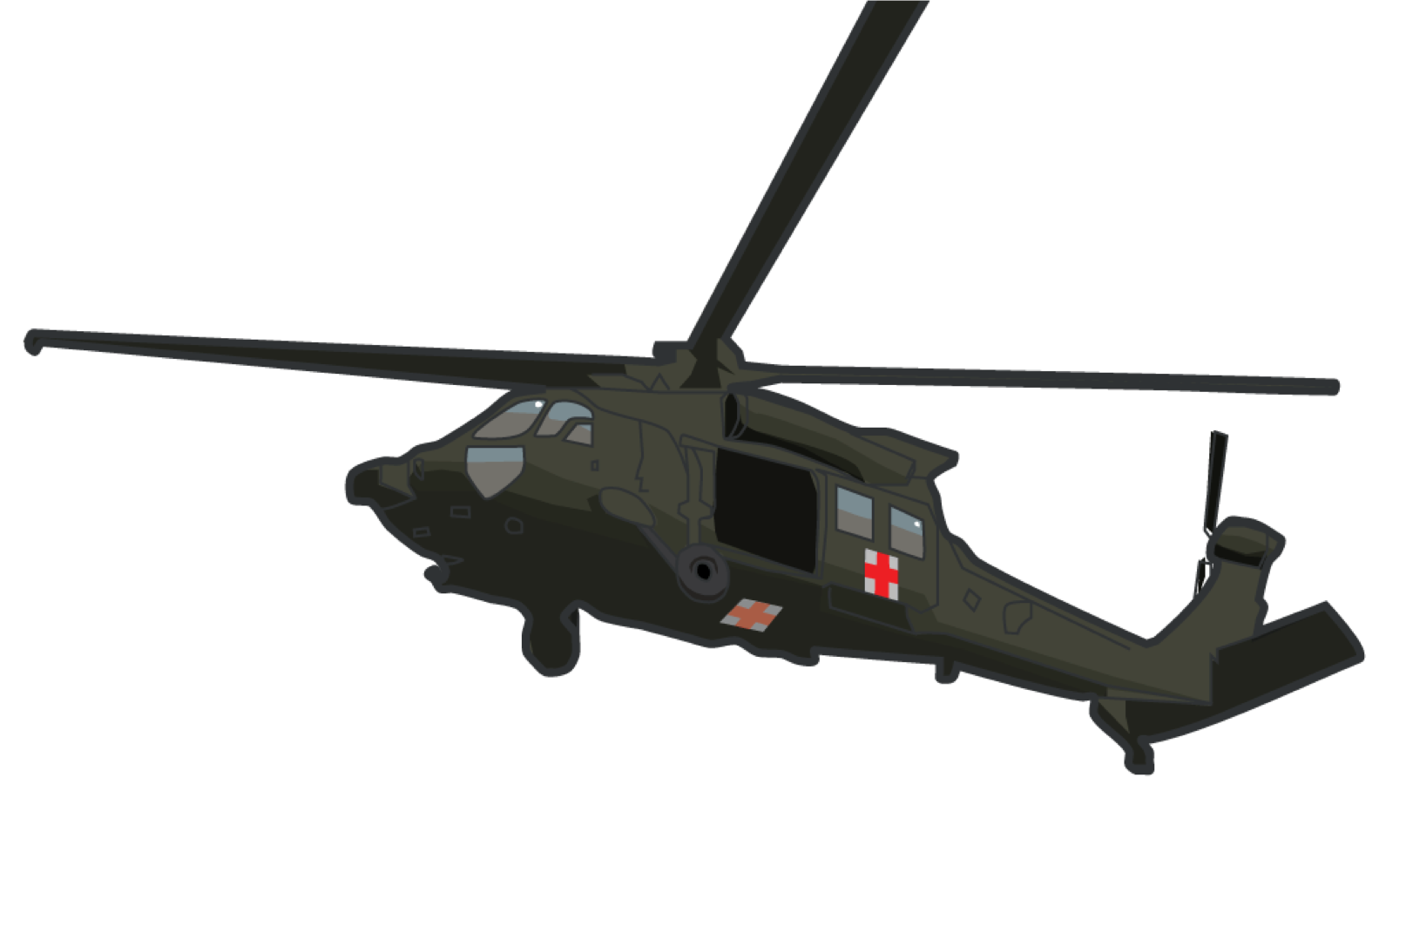
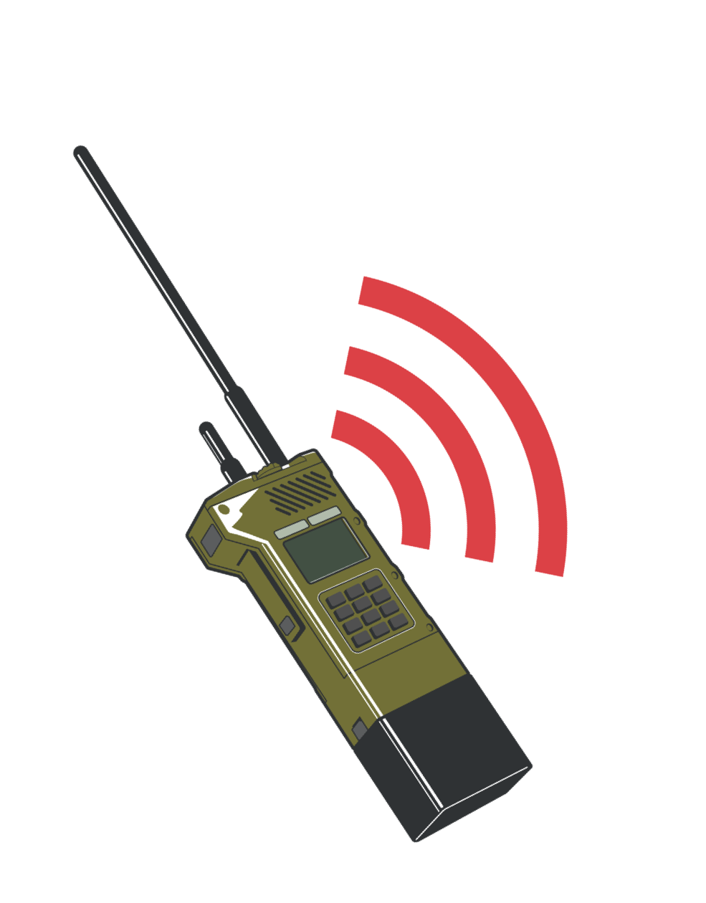
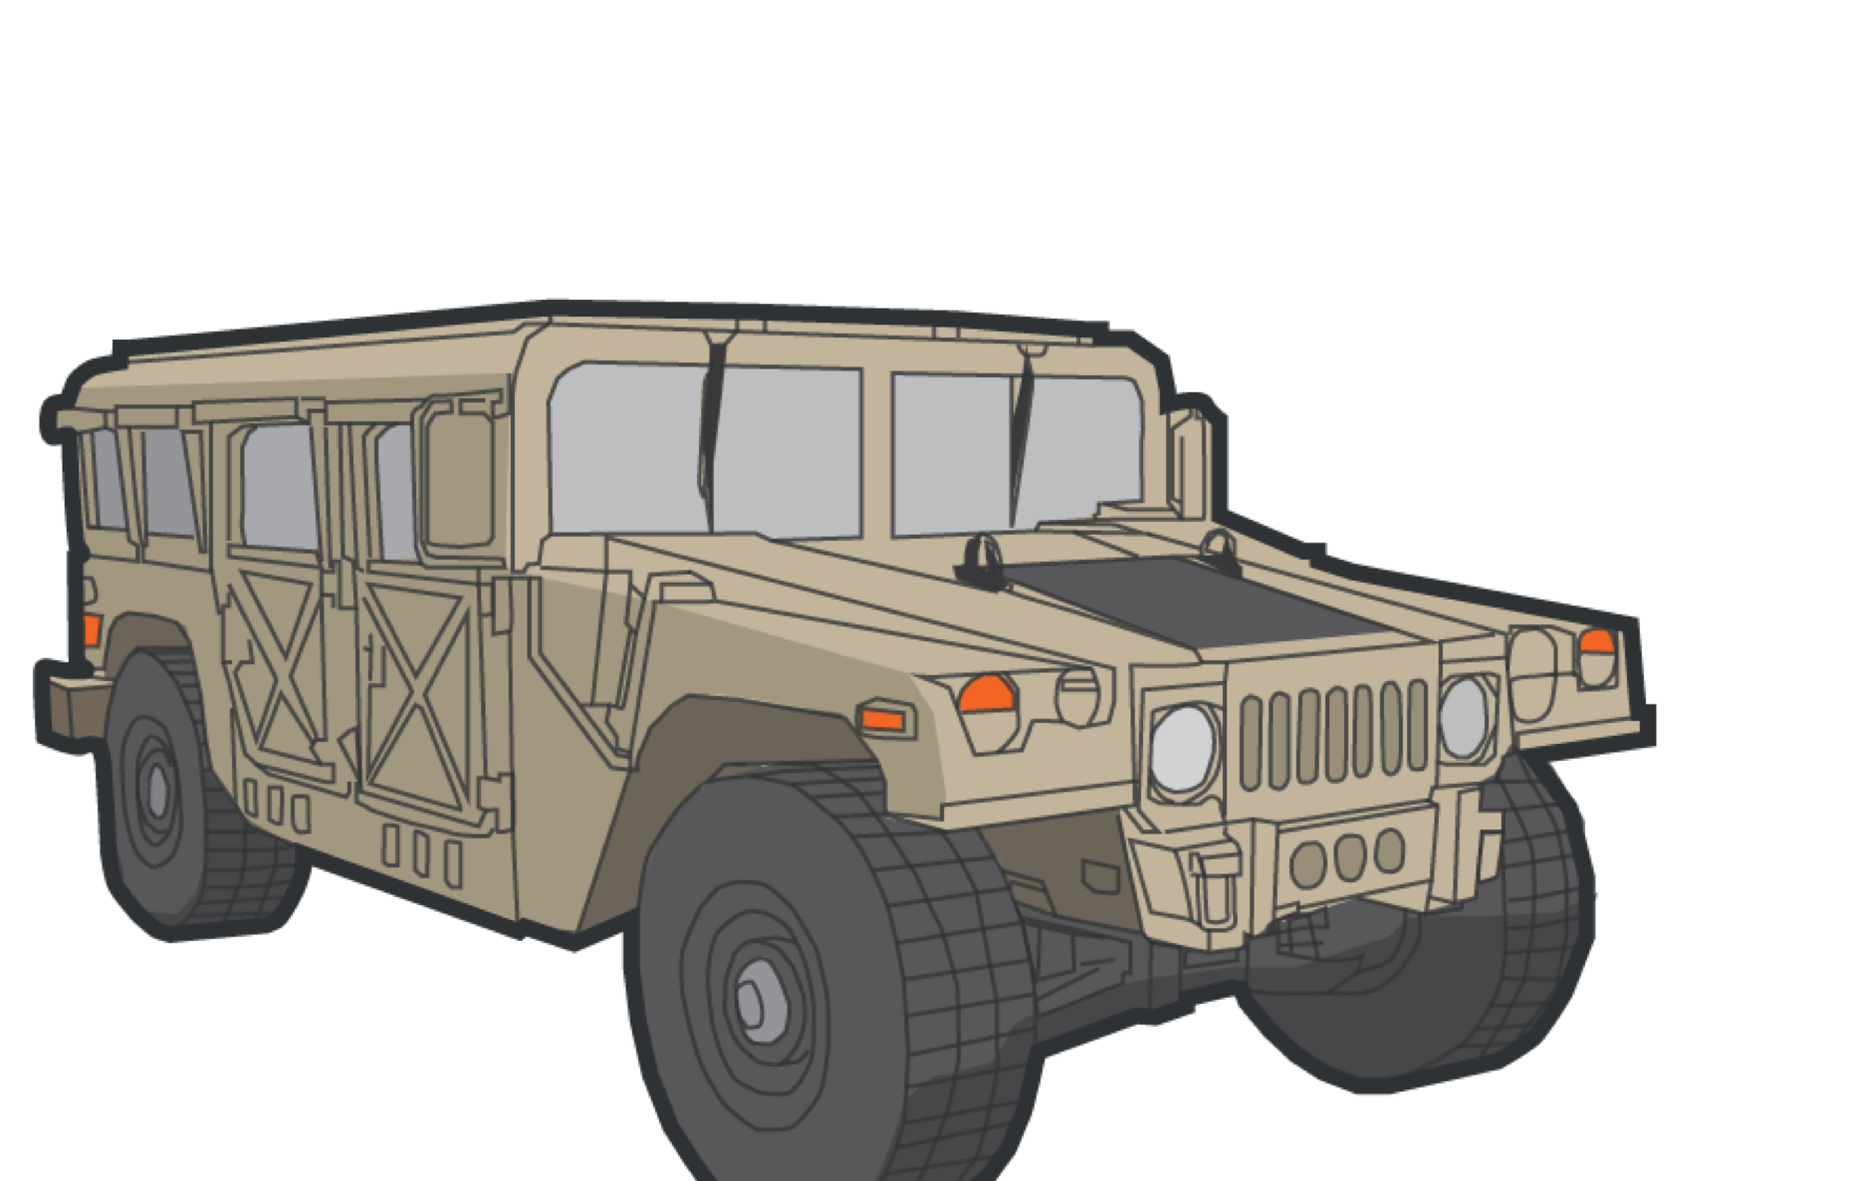

SUMMARY
We discussed the 9-Line and MIST Reports
We discussed requesting an evacuation of a casualty We identified over-categorization
We identified key information to relay to tactical leadership

Slide 17
CHECK ON LEARNING
With whom do you communicate in a casualty situation?
Which lines of a MEDEVAC must be transmitted for an asset to be launched? What information does the MIST Report contain?
Who should complete casualty care documentation on the DD Form 1380? Where can you find the DD Form 1380?

Slide 18
ANY QUESTIONS?

